Slide 1

The North American Microvascular Network
Nathaniel R. Smilowitz MD, MS
September 1st, 2025

Slide 2
Nathaniel Smilowitz, MD, MS
Advisory Board / Consulting:
Abbott Vascular, Boston Scientific, AngioInsight
Grant Support:
United States NIH NHLBI R34 HL173301

Slide 3

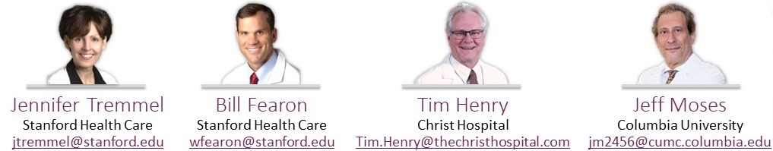


The Microvascular Network
To build and align a community of Coronary Microvascular Dysfunction advocates to advance diagnosis and treatment of patients and harmonize care guidelines.
Leadership Advisory Council:
Co-Directors:

Slide 4
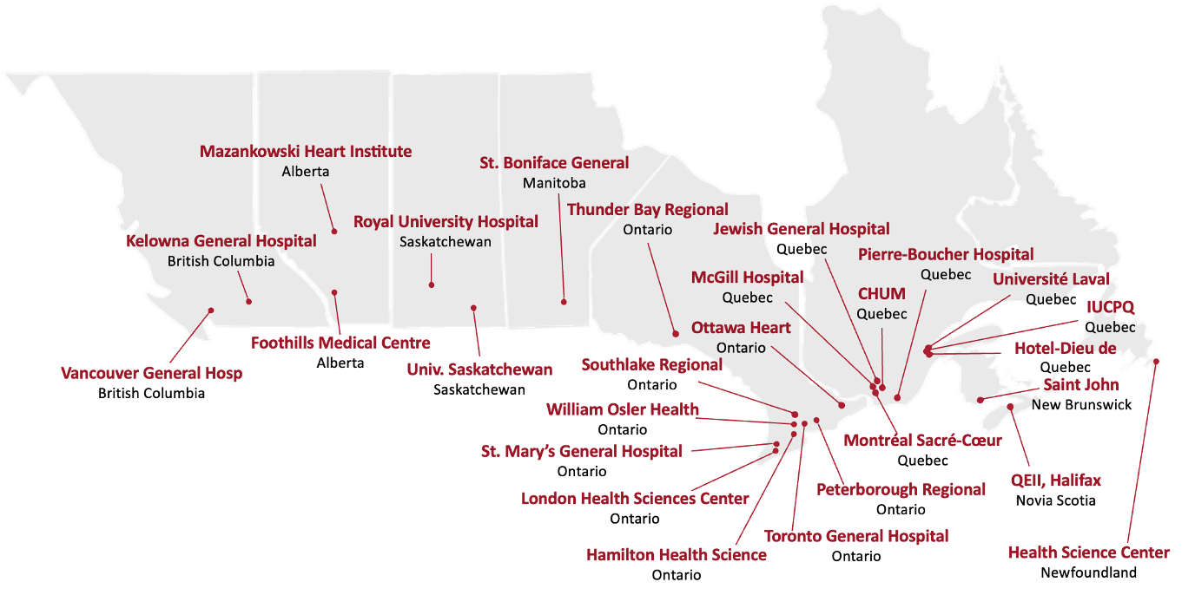
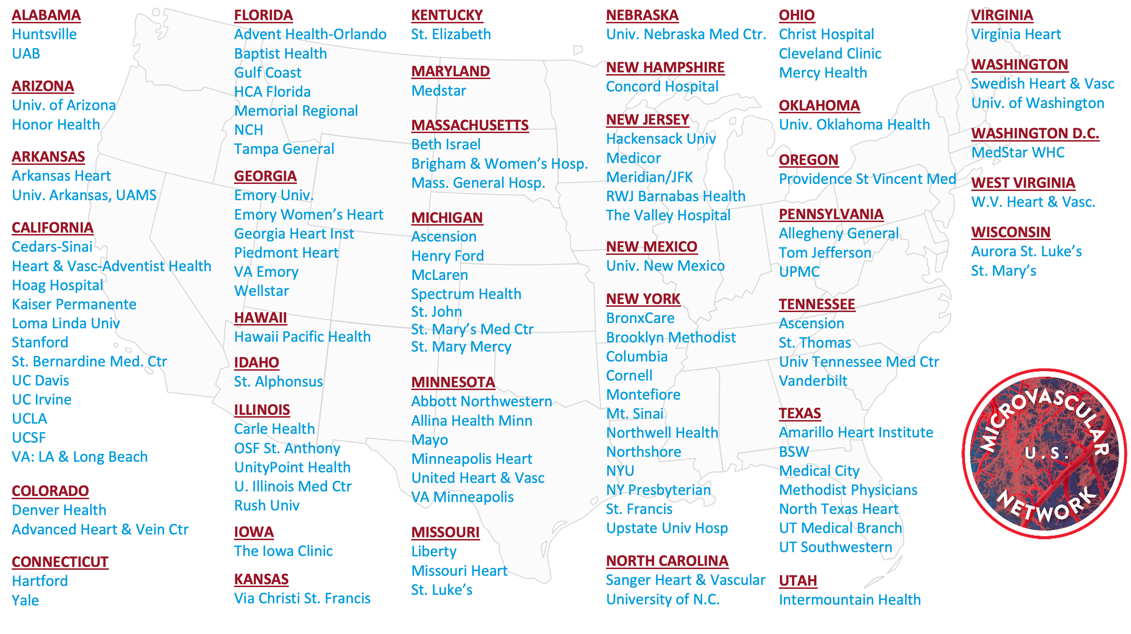
Growth of the MVN
Canada
United States
*
MVN Launched
* As of 5/19/25

Slide 5
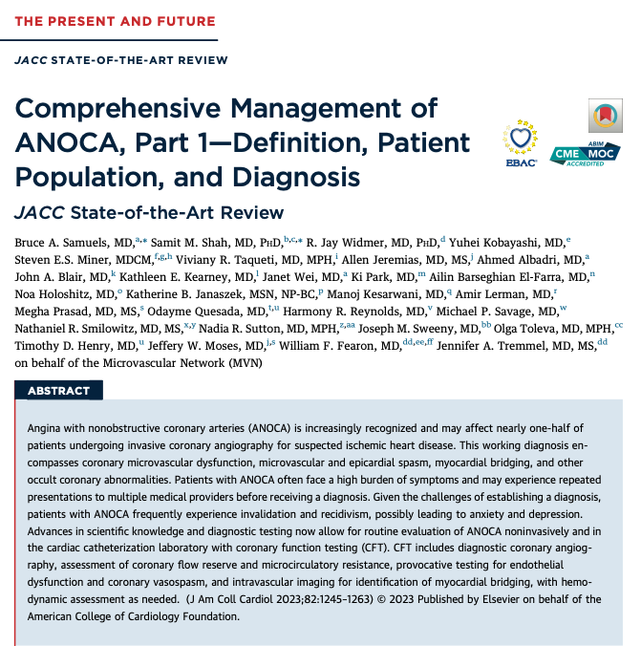
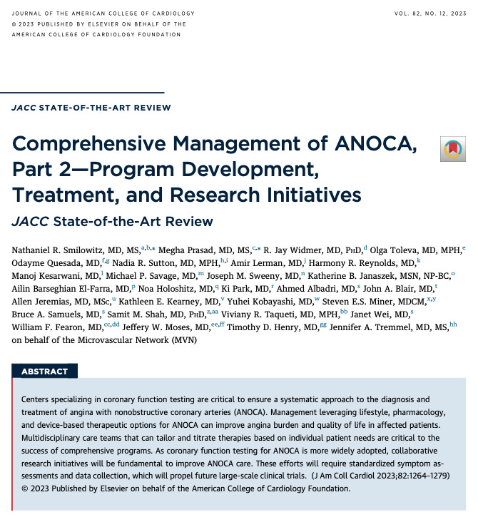
Encourages a systematic approach to diagnosis
Whitepapers & Expert Consensus Statements

Slide 6
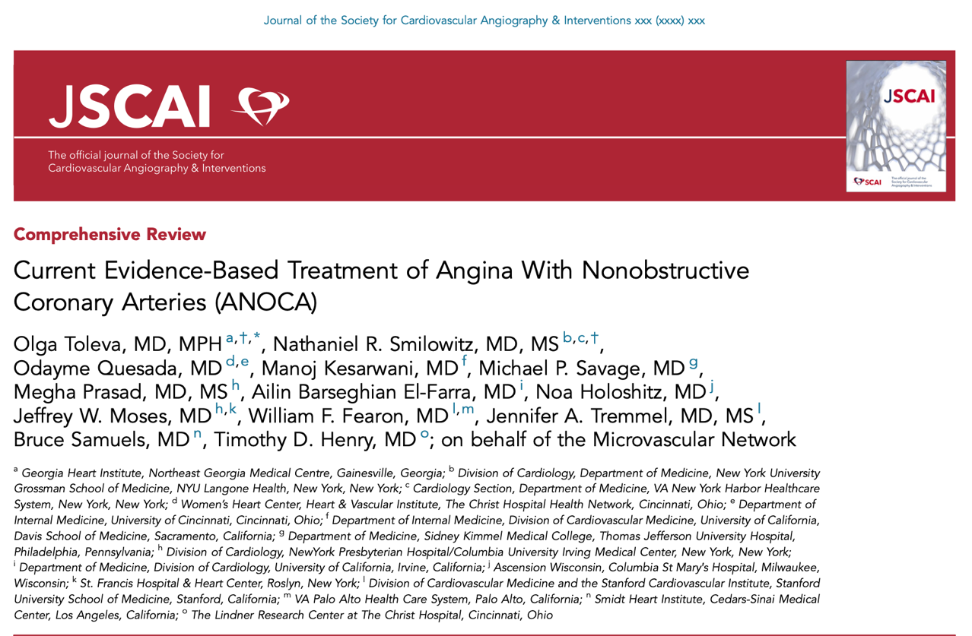
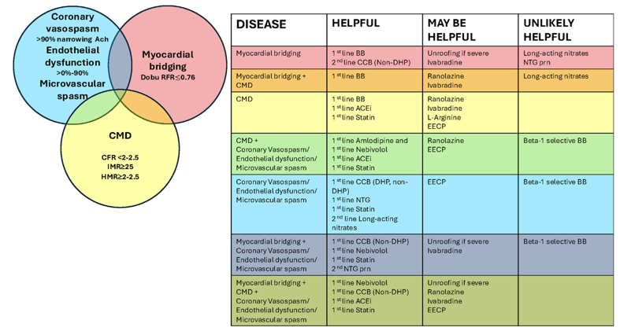
Review of the evidence for ANOCA treatment

Slide 7
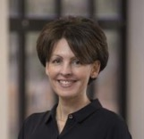
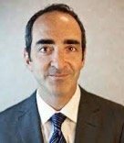

Research Activities in Progress
Dr. Jennifer Tremmel
Dr. Bruce Samuels
Microvascular Network Registry
To be housed at CRF
Multi-institutional governance
Protocol has been finalized, variables selected
Registry to be industry-funded; startup funding secured
Prospective primary data collection
The registry will serve as a platform for future clinical trials
MVN Registry kick-off once funding is secured
ANOCA Prevalence from the NCDR: CathPCI Registry
Contemporary Health Economics of ANOCA in the United States

Slide 8

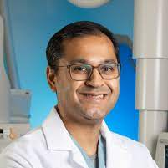
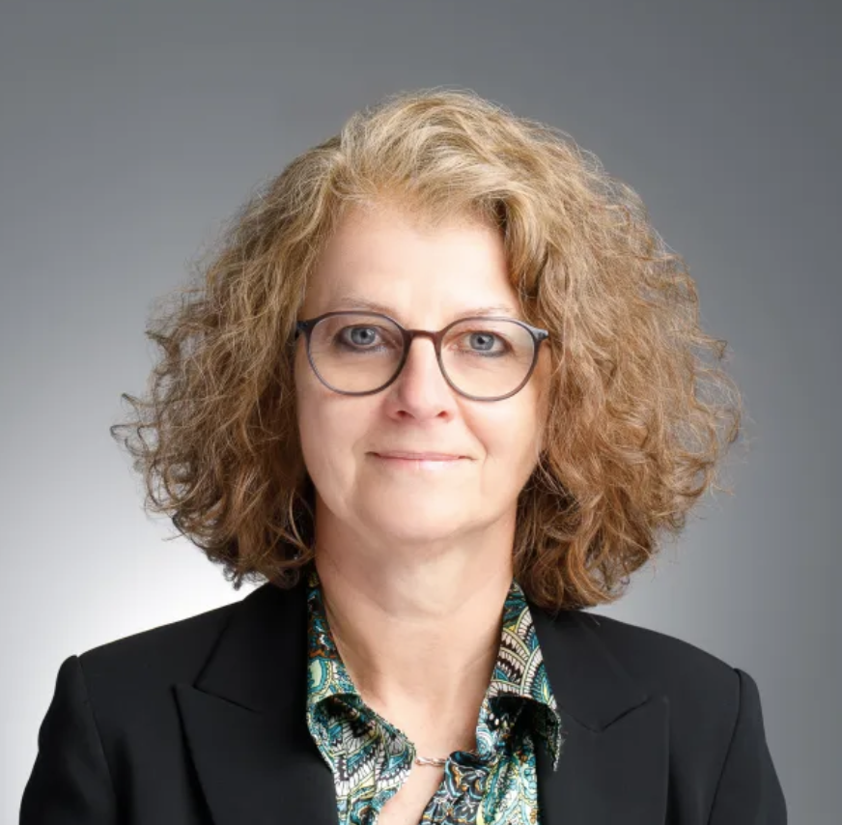

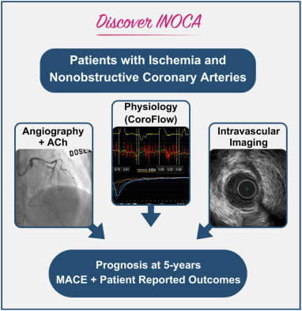
DISCOVER-INOCA
Dr. Samit Shah
Dr. Alexandra Lansky
Led by Yale - close partnership with MVN leadership and MVN member sites:
Yale, Stanford, Christ, NYU, Jefferson, NYP Columbia, NYP Methodist, Northeast Georgia, UCLA
Prospective observational study of INOCA
Patients undergo angiography, thermo-dilution CMD testing, CRT with ACh, intravascular imaging
Symptom Assessments, Patient Reported Outcome Measures, MACE at 5 years
> 408 / 500 patients enrolled
79% female, mean age 57 yrs, CMD: 15%, VSA: 42%, mixed CMD/VSA: 25%, Other: 9%, Nml: 7%
8

Slide 9
MVN Physician Education
CMD Forum: Virtual, final Monday of the month at 8:00 PM ET
Presentation by a national or international leader in INOCA / ANOCA / CMD: case presentations, research
Supported by Abbott Vascular Education
MVN leadership as moderators / discussants
70-100 attendees each month
2023:
March: Steve Miner
April: Bruce Samuels
May: John Blair
June: Samit Shah
July: Hayder Hashim
August: Nathaniel Smilowitz
September: Tim Henry
2024:
January: Joe Sweeny
February: Jay Widmer
March: Khalid Ziada
April: Sarah Murray
June: Dany Jacob and Samit Shah
July: Samip Vasaiwala
August: Hayder Hashim + Bruce Samuels
September: Olga Toleva
October: Ankur Gupta
November: Nathaniel Smilowitz and Megha Prasad
2025:
January: Tom Ford
February: Richard Sohn
March: Jon Spiro
April: Jennifer Tremmel + Jack Boyd
May: Odayme Quesada + Meghan Schmaltz
June: Nathaniel Smilowitz + Bruce Samuels
July: Olga Toleva
August: Nadia Sutton + Nishtha Sareen

Slide 10
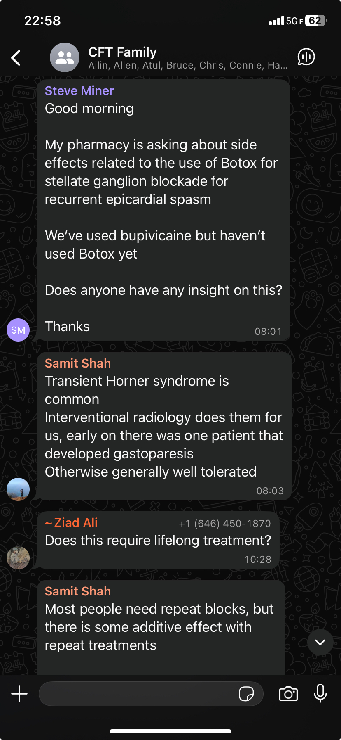



MVN Physician Education
CMD Forum: Virtual, final Monday of the month at 8:00 PM ET
Presentation by a national or international leader in INOCA / ANOCA / CMD: case presentations, research
Supported by Abbott Vascular Education
MVN leadership as moderators / discussants
70-100 attendees each month
MVN CFT WhatsApp Group
MVN Website Resources
Core reading materials
ICD10 / CPT codes / billing information
Physician toolkit

Slide 11
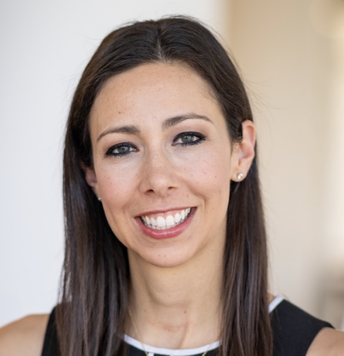
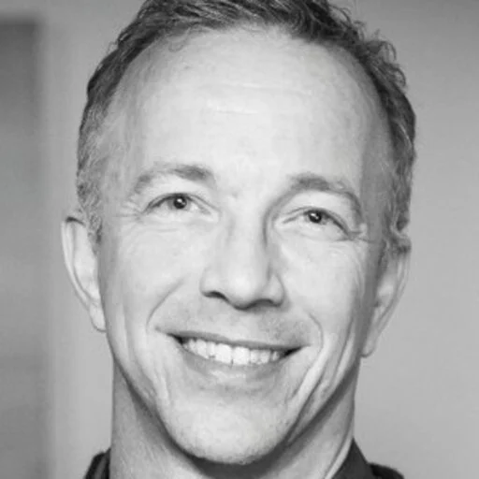
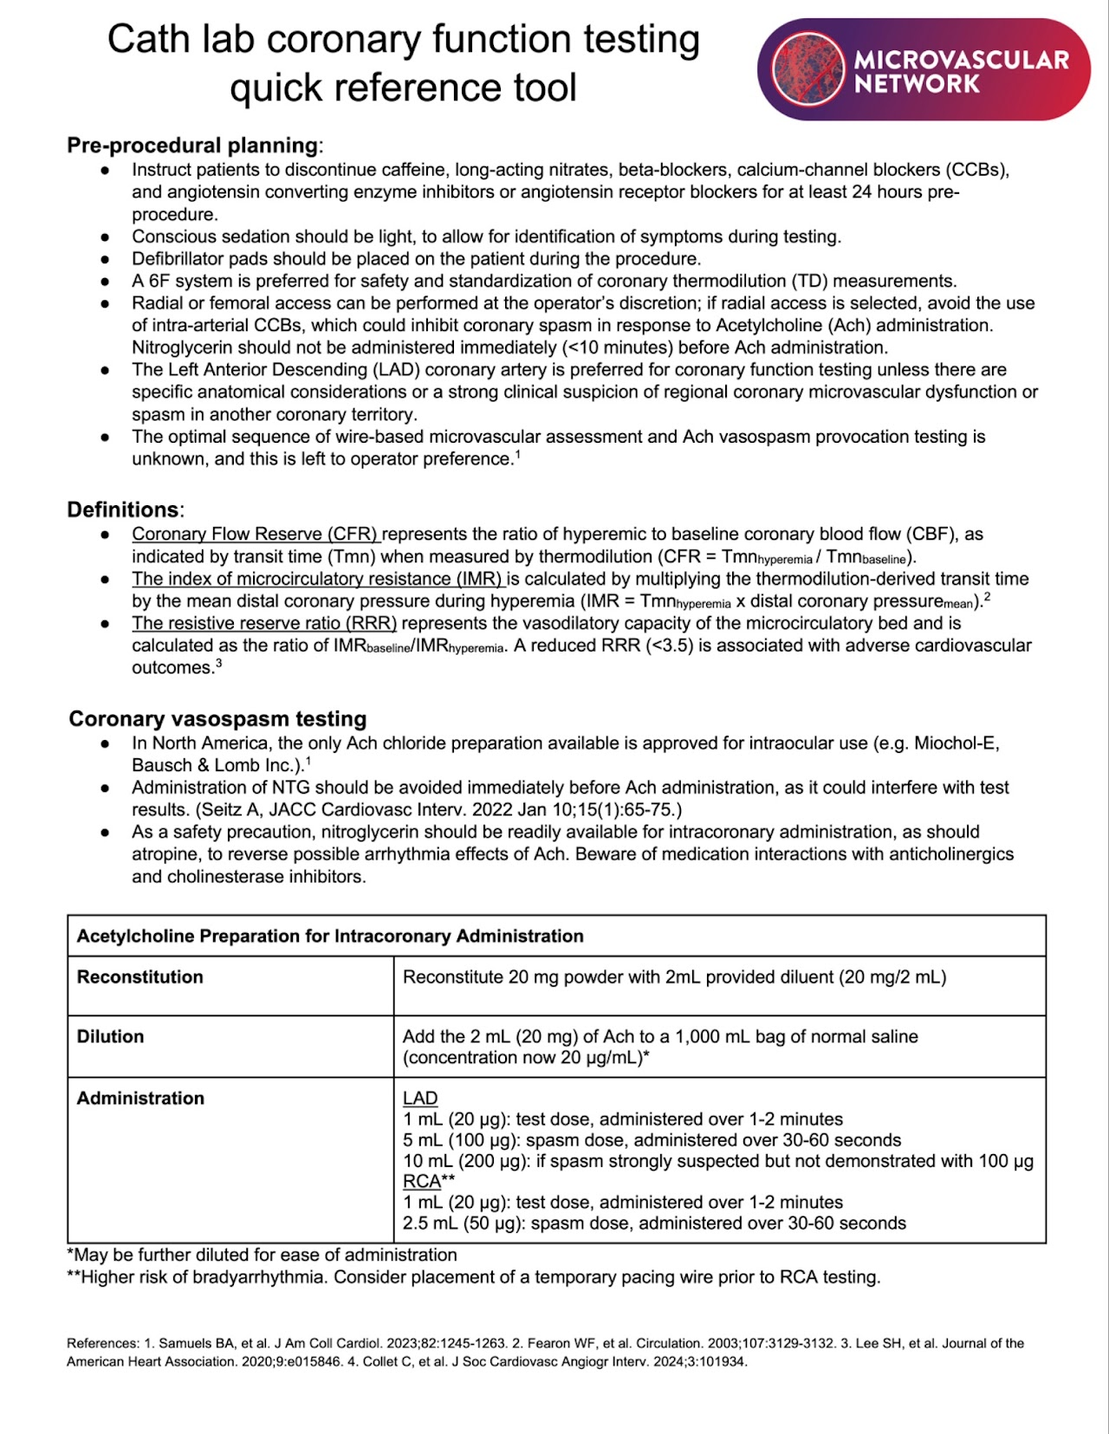
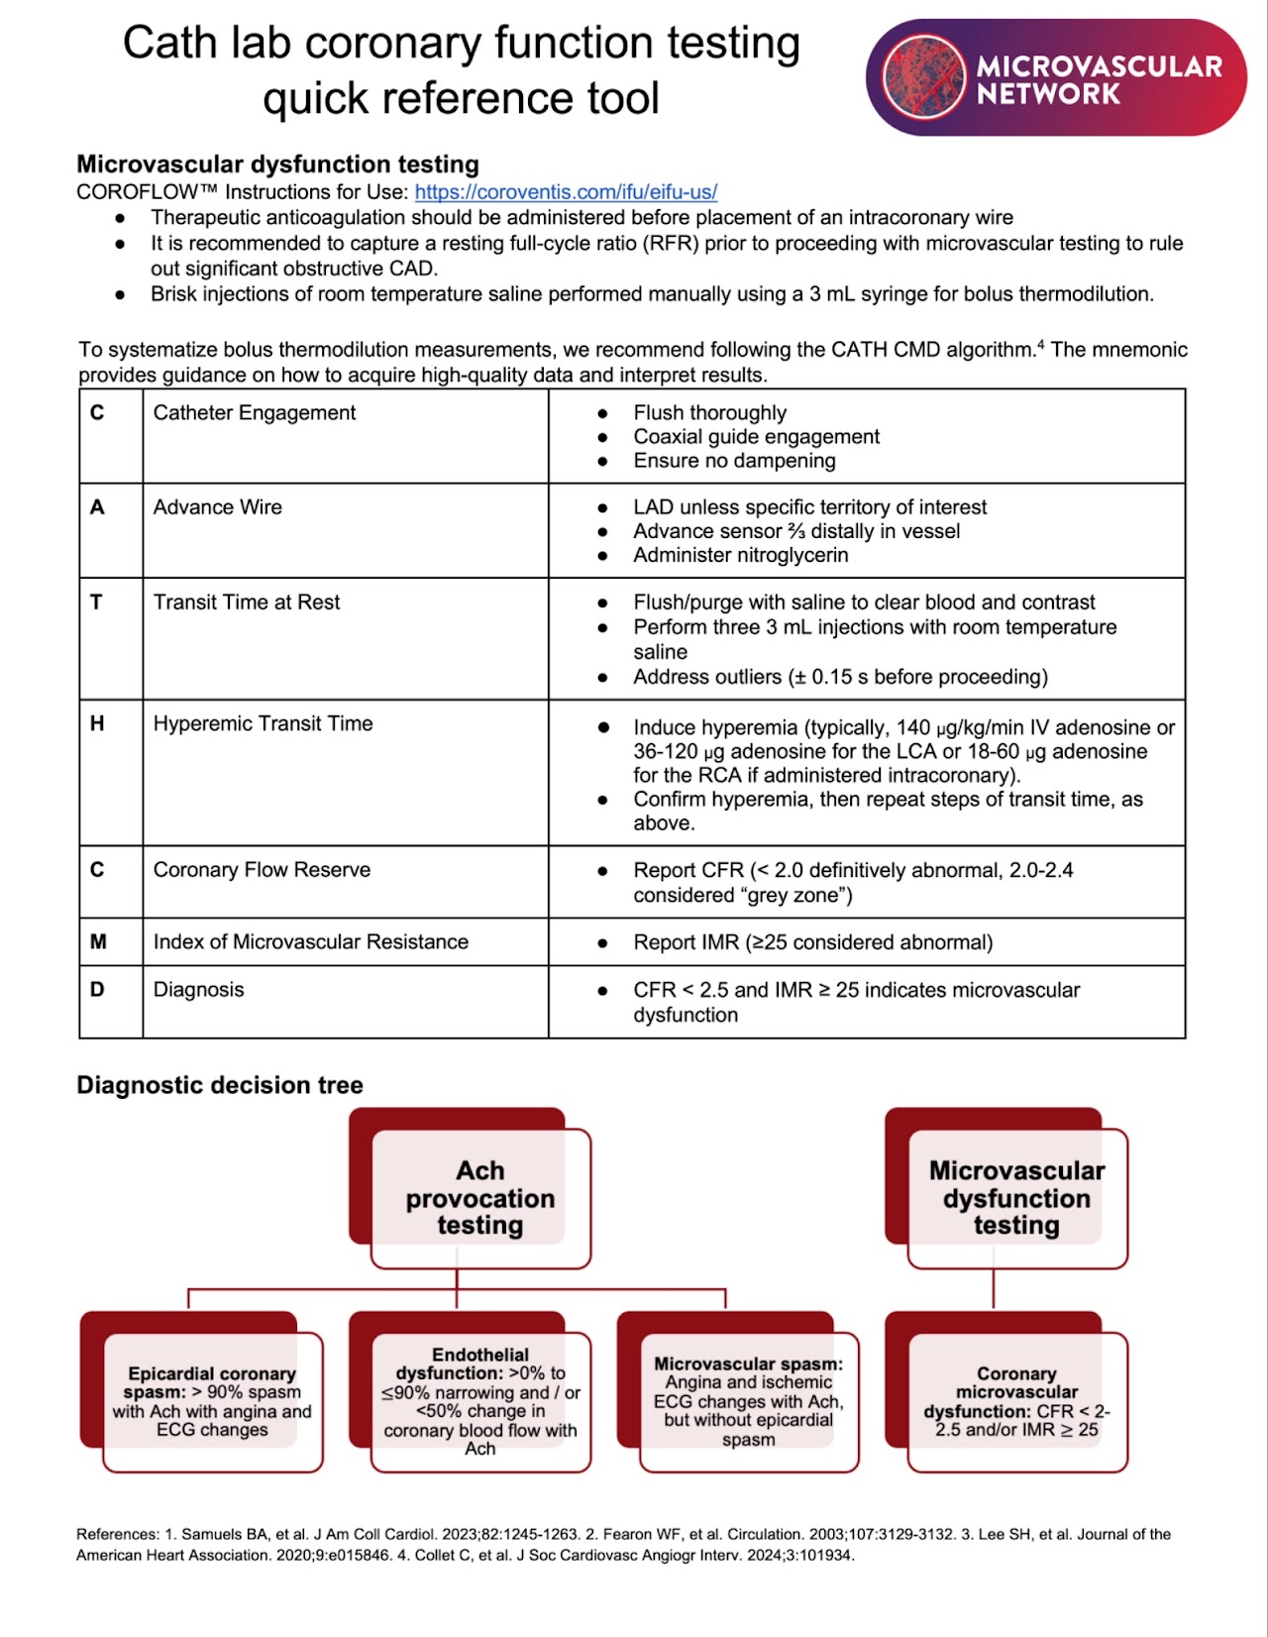
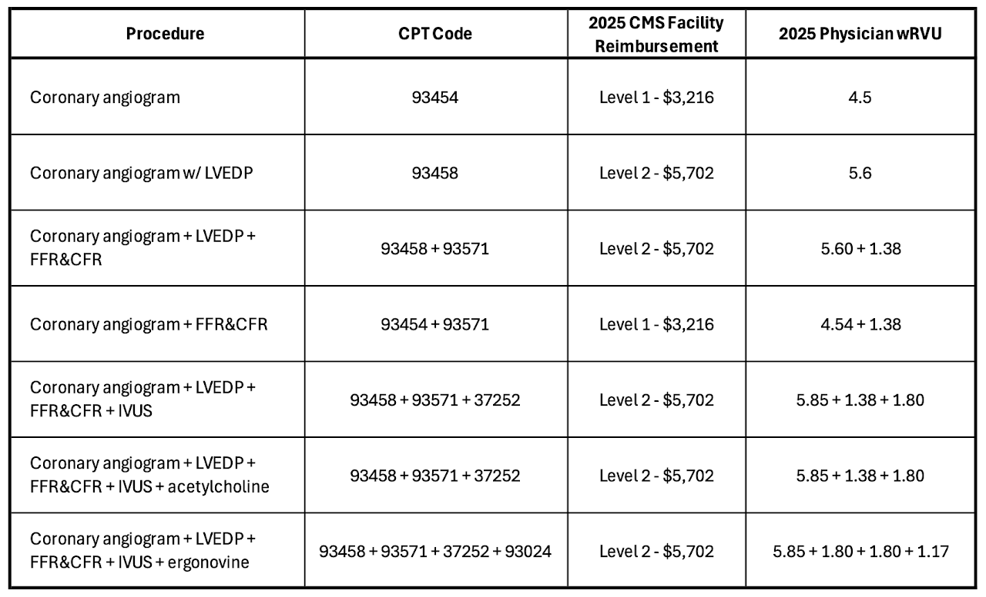
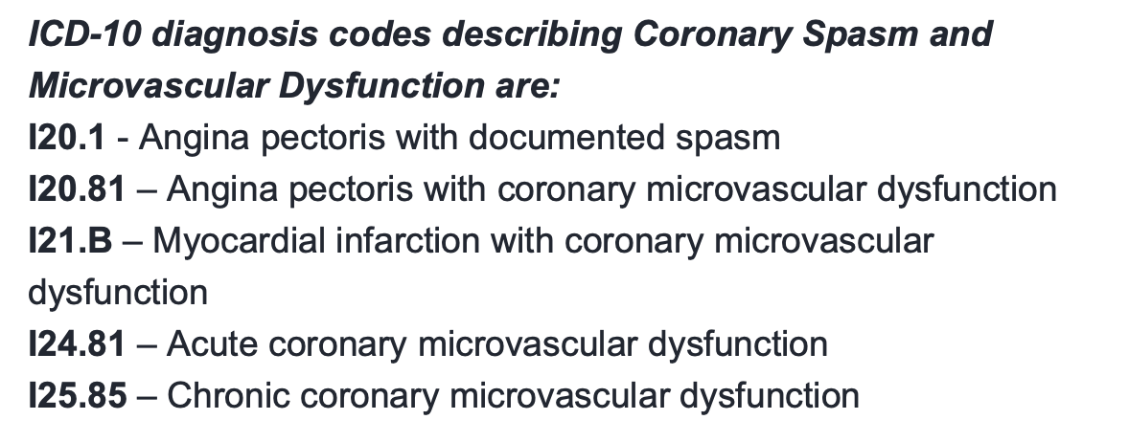
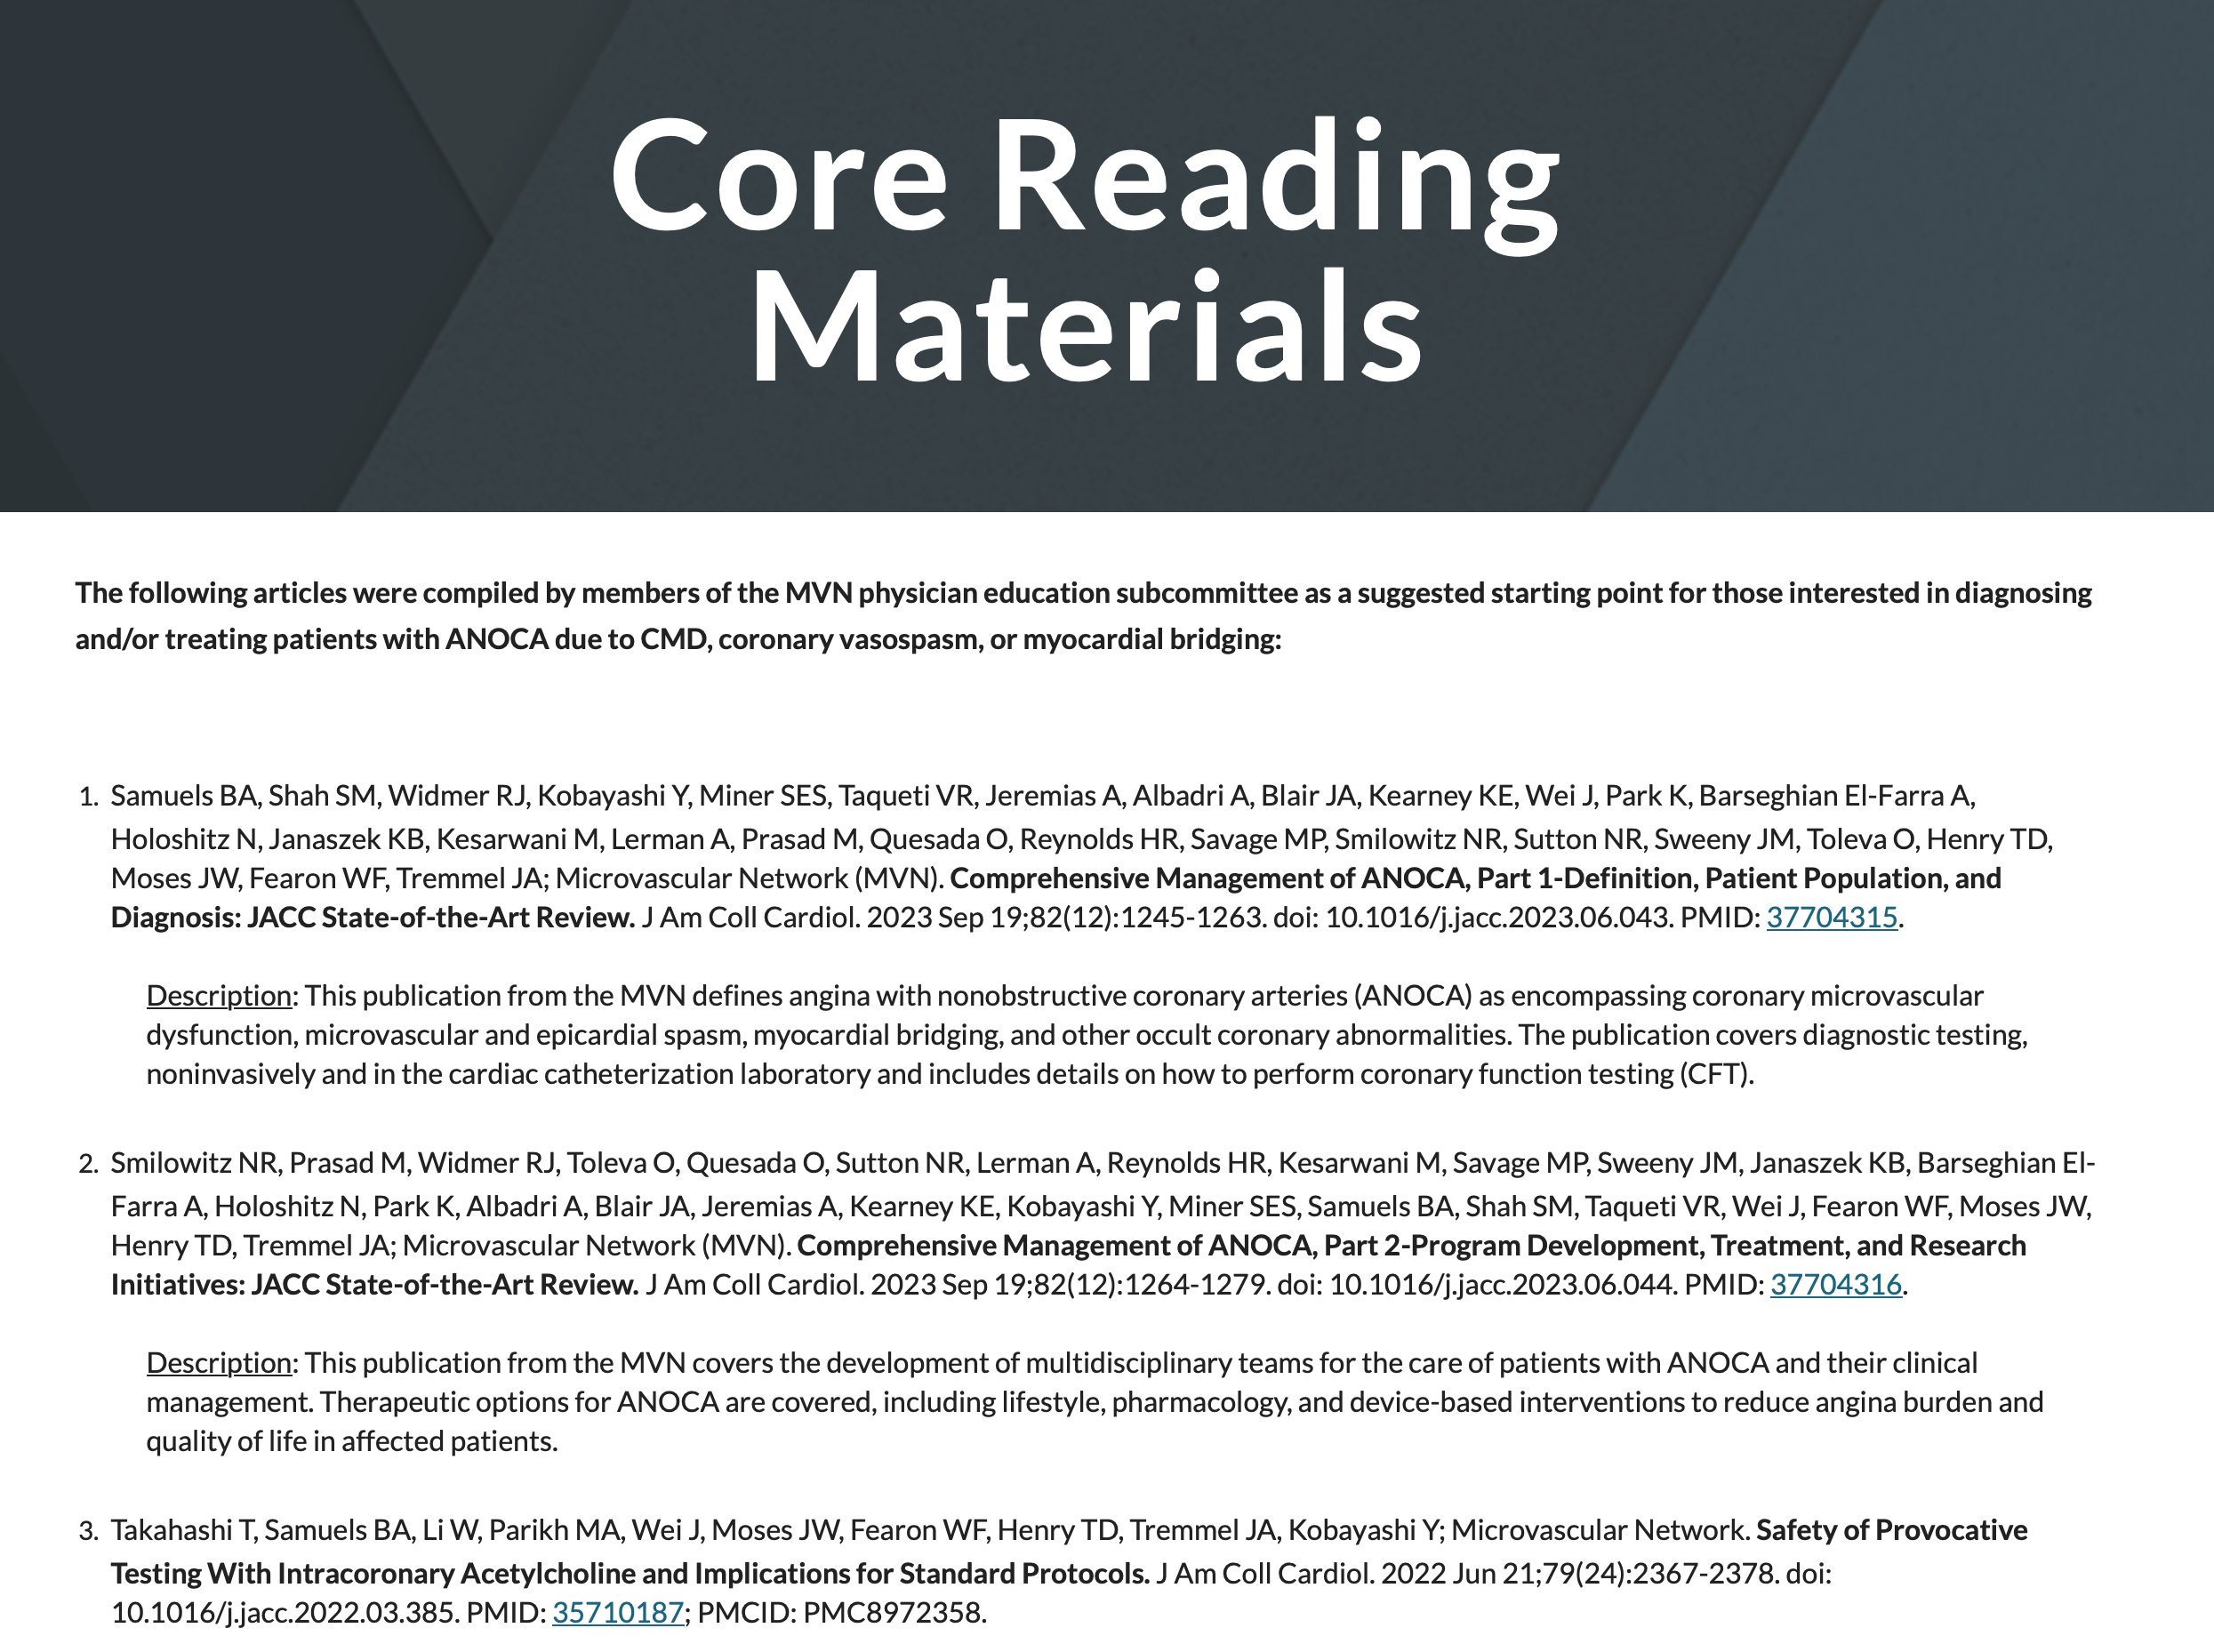
MVN Physician Education
Dr. Nadia Sutton
Dr. Steve Miner

Slide 12
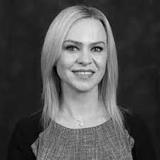
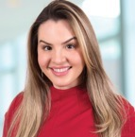
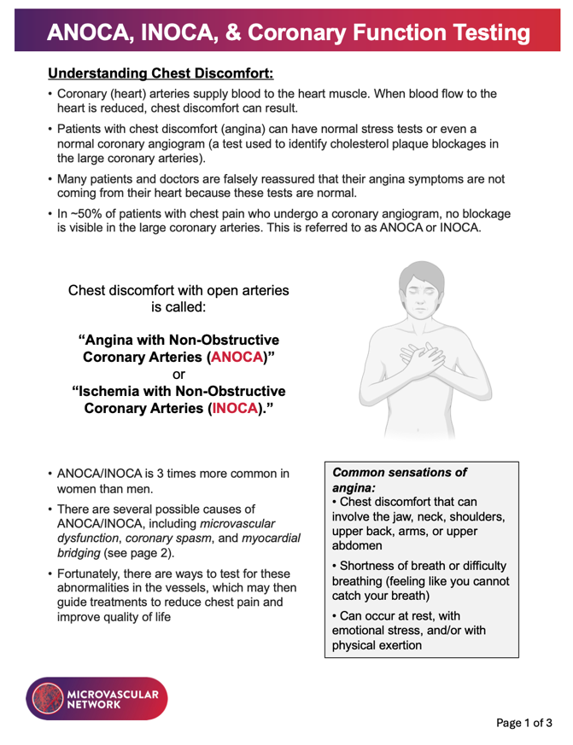
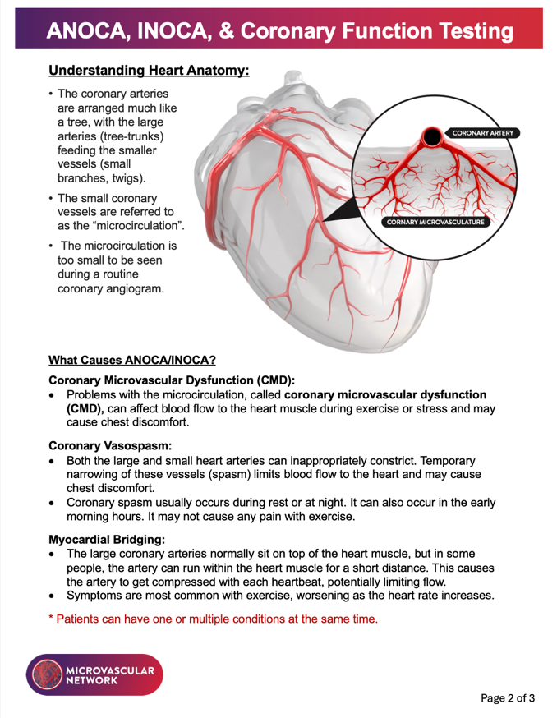
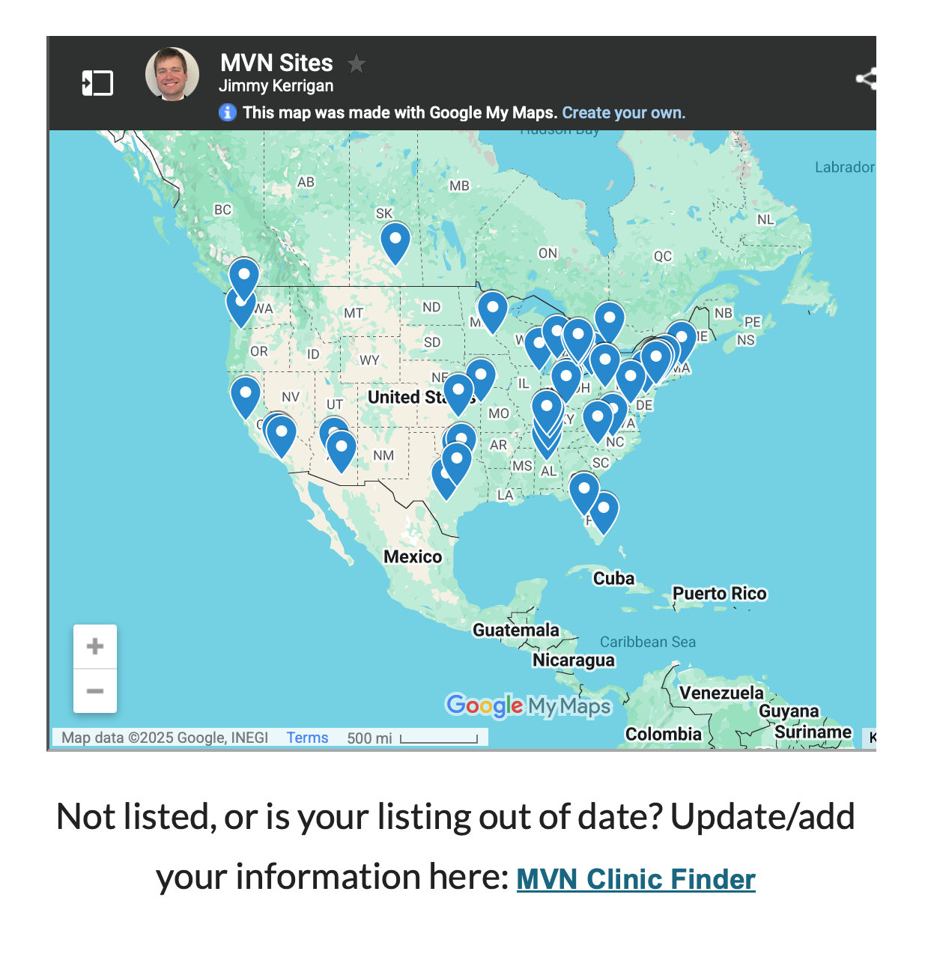
Patient Education Materials
Dr. Olga Toleva
Dr. Odayme Quesada
Connecting Patients & Providers in North America

Slide 13
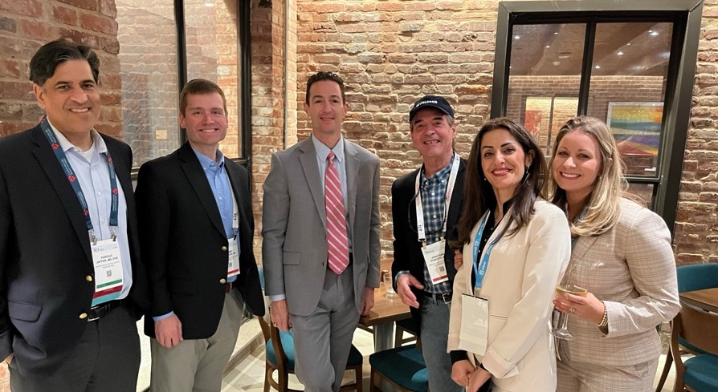
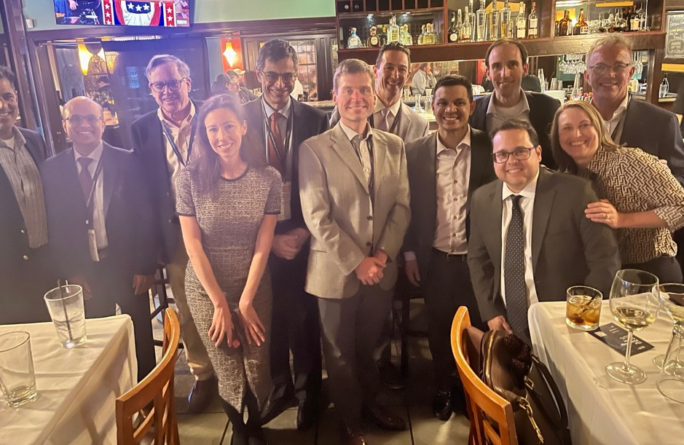
Thank you
Nathaniel.Smilowitz@nyulangone.org

